Slide 1



Annual project for the « FrenchTech »
RNCP Expert en Etude et Développement du SI
2018-2019

Slide 2

Project environment
1
1
This process begins with a request from a customer.
CAPSA is studying this request to design a container that meets the customer's needs.
Once the container is rehabilitated, it is delivered to the customer.
Between each rental a verification step is done. This step determines the need for a renovation. A report of the state of the container is then recorded.
2
2
3
#
3
#

Slide 3
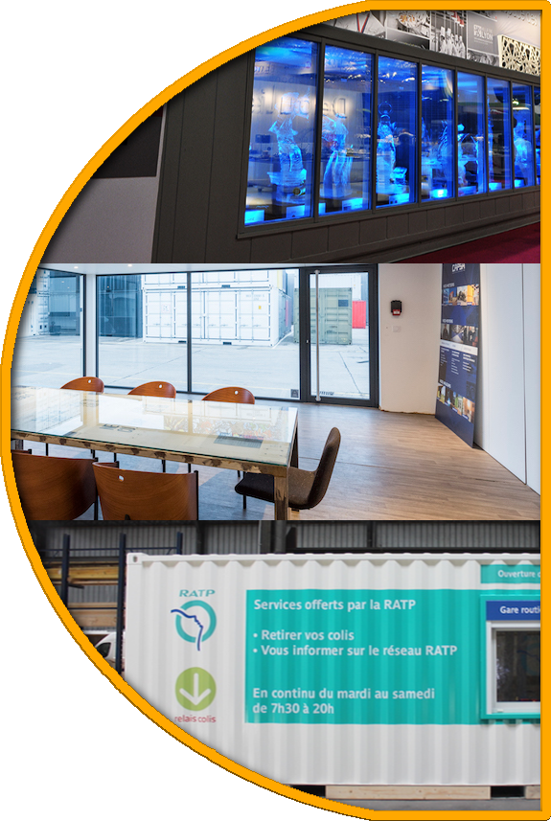
Existing - Problematic
VISIBILITY
CAPSA could improve its systems to gain real-time visibility into container status when rented by a customer. Having a permanent view on the condition of the containers could save travel moves.
TRACEABILITY
This same visibility could bring more traceability concerning the state of the containers, it would therefore be easier to determine the origin of the problems to improve the customer relationship in the event of a technical problem.
LOGGING
It is therefore possible to keep track of the container and use it to ease the detection of container needs such as the pace of renovations.

Slide 4

Given solution
1
1
Real time container state
A follow up with detailed activity history
2
2
Those two sides make sure to build true values and trust between the client and the seller
#
#
Notes:
On propose donc de développer un outil de visualisation, proposant :

Slide 5

What are our services?
1
Minimizing the officer's movements
Speed up the intervention process.
Reduced cost .
2
#

Slide 6
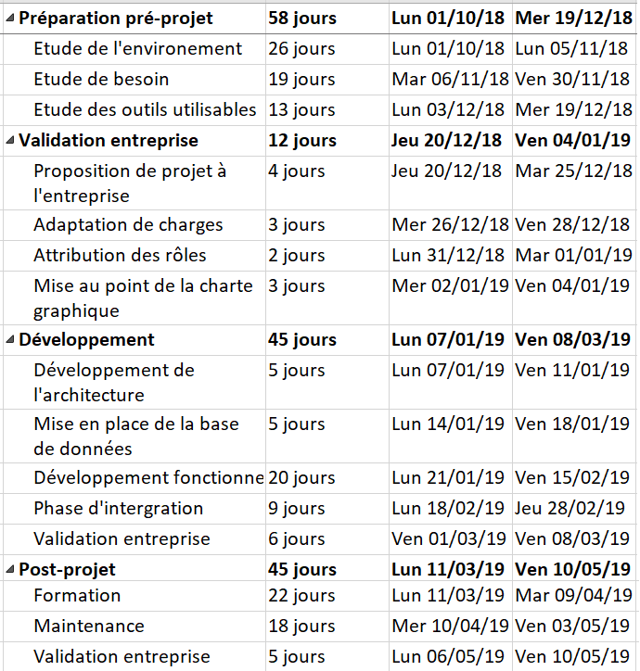
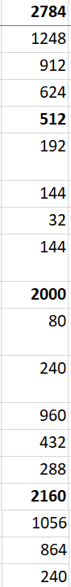
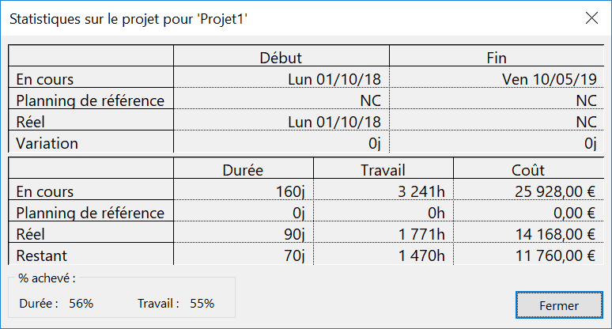
Costs and tasks flow :
7456€

Slide 7
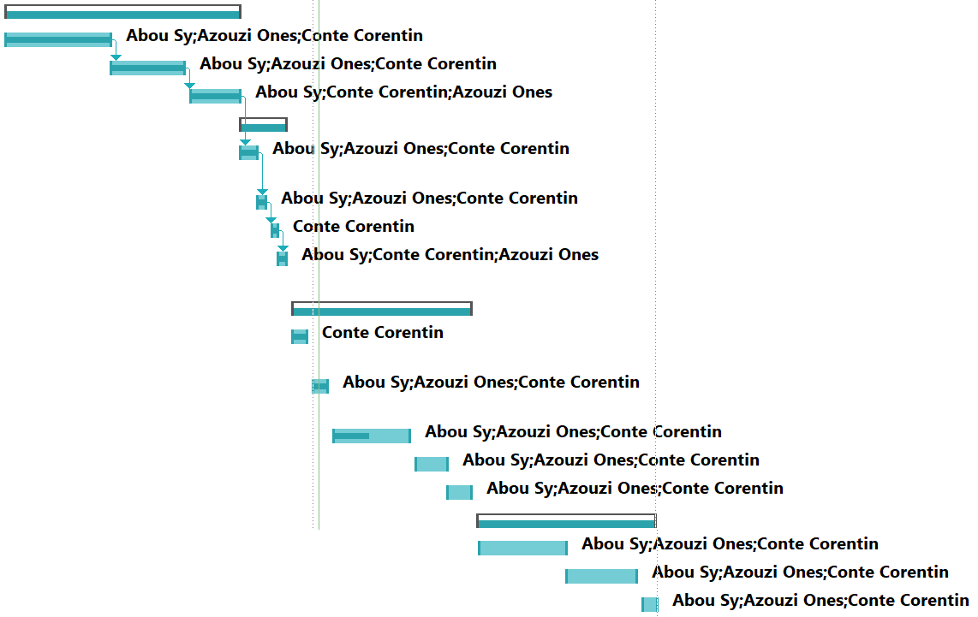
Progress of the tasks:

Slide 8
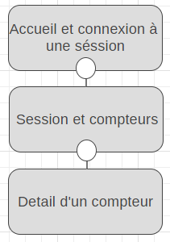
The architecture of the solution is as follows:
The architecture is simple so that the user is not confused when using the application

Slide 9
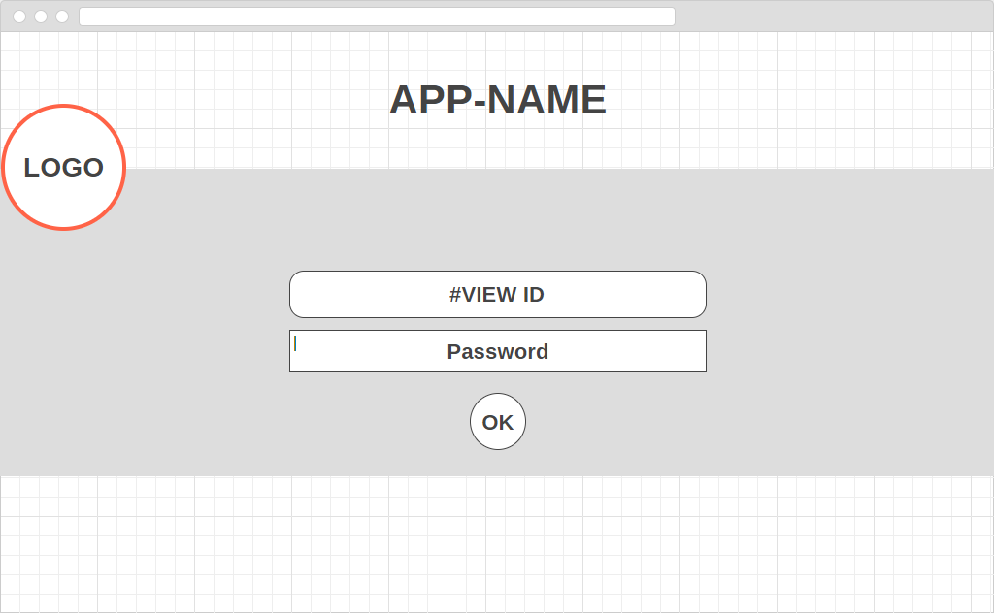
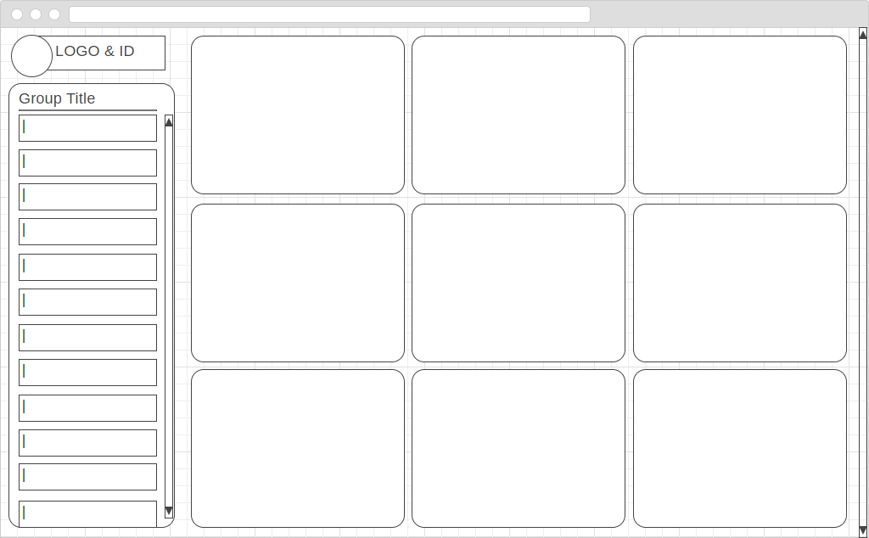
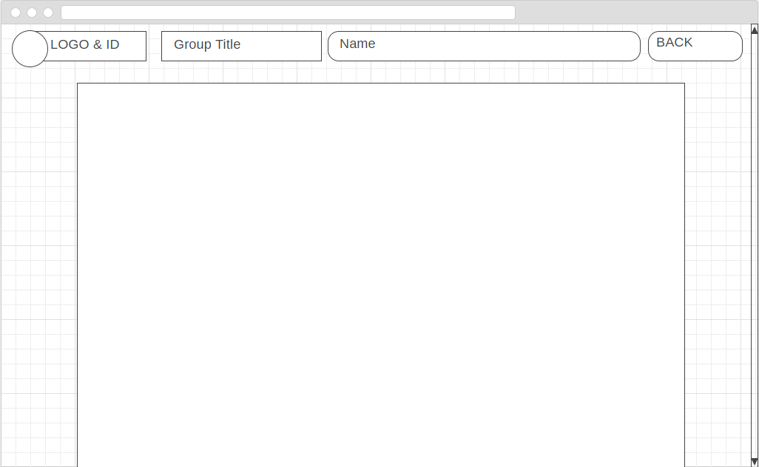
Home and login by Id of the selected view and password.
The first connection of a container to a view saves it in the database.
It is possible to put a container in several views.
The proposed solution is as follows
Each container displays a set of tiles corresponding to its modules information. It is possible to click on it to obtain the description page.

Slide 10




Project constraints

Slide 11
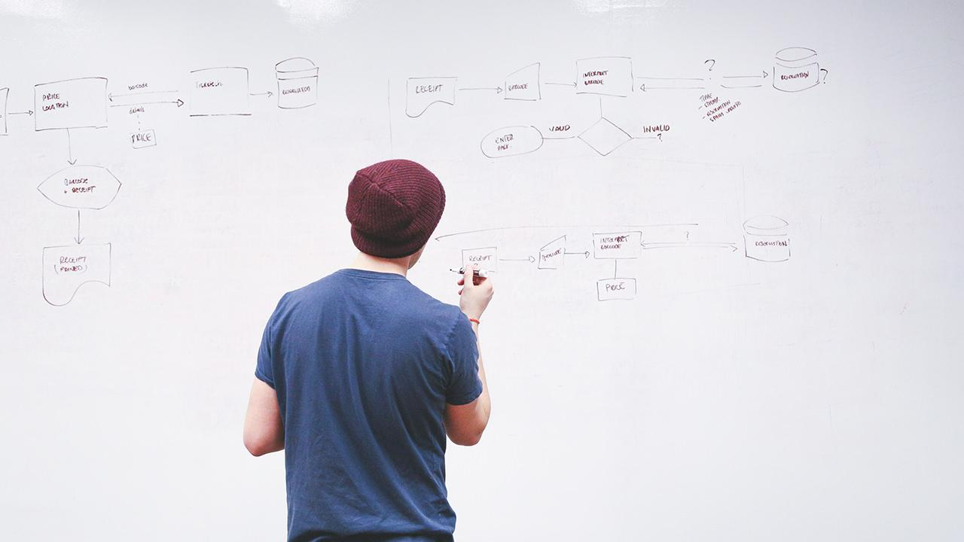



Expected delivery

